Slide 1
Web Application Architecture
Waqar Yar

Slide 2
Web Server
Web Server receives a URL request
The Web server sees that the request is for a Helper App.
The Web Server sends the parameters it gets from GET or POST
The helper app creates a brand new page can send the HTML back to the server.
As far as the server is concerned the HTML is a static page.
The helper App is shut down and the client gets back an HTML page.

Slide 3
Deploy and Project Run a Web
Project
src
classes
Etc
FirstServlet.java
Web.xml

Slide 4
public class HelloWorld extends HttpServlet {
private String message;
public void init() throws ServletException
{
// Do required initialization
message = "Hello World";
}
public void doGet(HttpServletRequest request, HttpServletResponse response)
throws ServletException, IOException
{
// Set response content type
response.setContentType("text/html");
// Actual logic goes here.
PrintWriter out = response.getWriter();
out.println("<h1>" + message + "</h1>");
}
}

Slide 5
Deploymnet Descriptor
Deployment descriptor describes how the web application should be deployed.
For web applications written using the Java programming language, the web application deployment descriptor is written using the Extensible Markup Language (XML) syntax.
The web application deployment descriptor is named web.xml
When included with a web application, it must reside in a WEB-INF subdirectory at the web application root.

Slide 6
Container
The server does not hands the request to the servelet directly
It hands it over to the Container.
The servlet is deployed in the container
It’s the Container which gives the HTTP request and response.
The container calls the servlets methods eg: doGet(), doPost()

Slide 7
What does a Container Give us?
Communication Support
The container knows the protocol between the web server and itself.
Lifecycle Management
The container controls the life and death servlet.
Multithreading support
The container creates a new Java thread for each servlet request it gets
Declarative Security
The containers uses XML deployment descriptor where security can be defined declaratively.
JSP Support
JSP code is converted to java by the container.

Slide 8
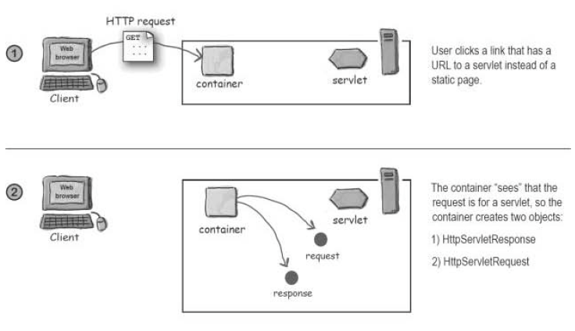
How a Container Handles a Request.

Slide 9
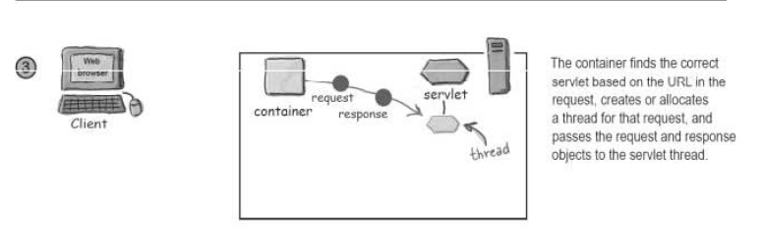
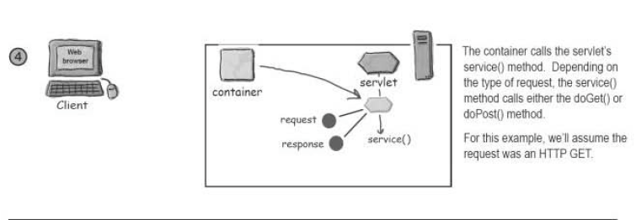

Slide 10
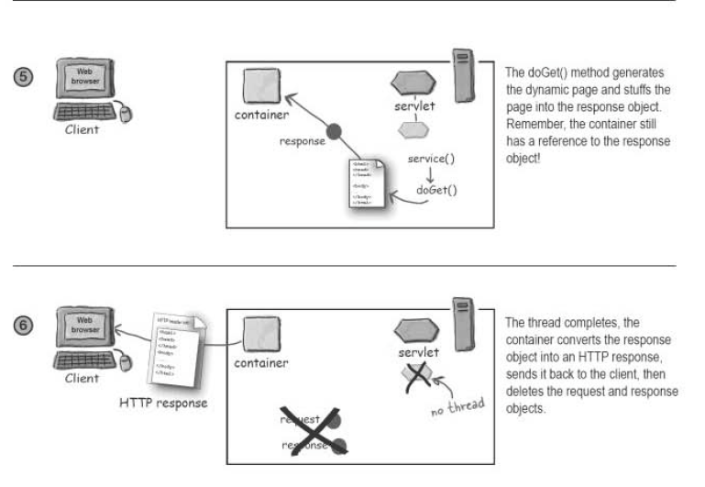

Slide 11
How does the container find a Servlet?
File path name:
This is the name the developer gives to the servlet.
Deployment name:
In the deployment descriptor we can give it an internal name called the deployment name.
Public URL name:
This is the name the rest of the world know. This is a URL a user enters to get to that servlet.

Slide 12
MVC
Model:
Model holds the real business logic and sate. It is the only part which talks to the DB.
View:
Responsible for the presentation. It gets the state of the model from the controller. It also gets user input that goes back to the controller.
Controller:
Takes the user input from the request and figuers out what it means for the model. Tells the model to update itself and makes the new model state available for the view (JSP)

